Slide 1
AI/ML Internship Project
Intelligent Customer Churn Prediction
& Customer Risk Analysis System
Presented by:Neha Pandey
Role:AI/ML Intern
Notes:
Welcome everyone — this is my AI/ML internship project: the Intelligent Customer Churn Prediction and Customer Risk Analysis System.
My name is Neha Pandey, and I worked on this as an AI/ML Developer Intern. In the next few minutes I'll walk you through the full journey: the problem, the data, the models, and the final customer risk report.
Key points: ① Project title ② My role as AI/ML intern ③ What the audience will see
Duration: 0.5 minutes

Slide 2
About the Project
During my internship, I worked on a Customer Churn Prediction project.
The main idea was to find customers who may leave a company.
What did I work on?
I built a system that
I used customer information such as:
predicts customer churn —
Monthly charges · Tenure · Usage · Login frequency · Support tickets
Complaints · Customer satisfaction
who is likely to leave,
and why.
Based on this data, I trained Machine Learning models to predict churn.
“Which customers are more likely to leave?”
The core question this project answers.
Customer Churn Prediction & Risk Analysis
03 / 18
Notes:
[Transition] Now, let me tell you what I actually worked on day to day.
During my internship, I worked on a Customer Churn Prediction project. The main idea was simple: find customers who may leave a company, using customer information like monthly charges, tenure, usage, login frequency, support tickets, complaints, and satisfaction scores.
[Data] I trained Machine Learning models on this data, so the project ultimately answers the question: "Which customers are more likely to leave?" [Pause]
Key points: ① Churn prediction project focus ② The customer data I used ③ The core question answered
Duration: 1 minute

Slide 3
Problem Statement
The Problem
Companies have many customers, so it is difficult to
manually identify which customers may leave.
I WANTED TO BUILD A SYSTEM THAT COULD
01
02
Analyze customer data
Find patterns related to churn
Understand the dataset and its structure.
Spot the behavior behind customer loss.
03
04
Predict the possibility of a customer leaving
Divide customers into different risk levels
Estimate churn probability for each customer.
Group customers by how likely they are to leave.
Customer Churn Prediction & Risk Analysis
04 / 18
Notes:
[Transition] With that context, here is the problem I set out to solve.
Companies have many customers, so it is very difficult to manually identify which customers may leave. So I wanted to build a system that could analyze customer data, find churn-related patterns, predict the possibility of a customer leaving, and divide customers into different risk levels.
[Pause] Notice the shift — from a manual, effort-based process to an automated, data-driven one.
Key points: ① Manual identification does not scale ② Four system goals ③ From manual to automated
Duration: 1 minute

Slide 4
Project Objectives
What I wanted to achieve
01
02
03
04
05
Understand the
Clean the data
Analyze customer
Find important
Create useful
customer dataset
behavior
churn-related factors
features
06
07
08
09
10
Train different
Compare model
Predict churn
Assign customer
Generate a
ML models
performance
probability
risk levels
customer risk report
Customer Churn Prediction & Risk Analysis
05 / 18
Notes:
[Transition] Based on that problem, these were my ten objectives for the project.
My goal was to cover the complete pipeline: understand the dataset, clean the data, analyze customer behavior, find important churn-related factors, create useful features, train different ML models, compare their performance, predict churn probability, assign risk levels, and finally generate a customer risk report.
[Pause] So no matter what comes next, it all traces back to one of these ten steps.
Key points: ① Ten objectives across the full pipeline ② From data understanding to final report ③ The pipeline is end-to-end
Duration: 1 minute

Slide 5
Dataset
Dataset Used
CUSTOMER RECORDS
ORIGINAL COLUMNS
DATA TYPES
10,000
18
2
customer records
original features
numerical + categorical
Some important columns
Age
Tenure
Monthly Charges
Total Charges
Login Frequency
Support Tickets
Complaints
Usage Hours
Customer Satisfaction
Churn
Target Column: Churn
0
Customer stayed
1
Customer left
Customer Churn Prediction & Risk Analysis
06 / 18
Notes:
[Transition] Let me now describe the data I worked with.
The dataset contained 10,000 customer records and 18 original columns, mixing numerical and categorical data. Key columns included age, tenure, monthly charges, total charges, login frequency, support tickets, complaints, usage hours, and customer satisfaction.
[Data] The target column was Churn, where 0 means the customer stayed and 1 means the customer left. [Pause]
Key points: ① 10,000 records, 18 columns ② Mix of numerical and categorical data ③ Churn is the binary target (0 = stayed, 1 = left)
Duration: 1 minute

Slide 6
Project Workflow
How I worked on the project
01
02
03
04
Customer Data
Data Cleaning
Data Analysis
Feature Engineering
08
07
06
05
Model Evaluation
ML Models
Train/Test Split
Encoding
09
10
11
Churn Prediction
Risk Classification
Customer Risk Report
Customer Churn Prediction & Risk Analysis
07 / 18
Notes:
[Transition] Here is the workflow that ties all the steps together — this is the spine of the whole project.
I moved through eleven stages: starting with customer data, then data cleaning, data analysis, feature engineering, encoding, train/test split, ML models, model evaluation, churn prediction, risk classification, and finally the customer risk report.
[Pause] You can read this as a single funnel — raw data enters at the top, a business-ready risk report comes out at the bottom.
Key points: ① Eleven sequential stages ② Every step feeds the next ③ Raw data in, risk report out
Duration: 1.5 minutes

Slide 7
Data Cleaning
Checked missing values
What I checked
Checked duplicate Customer IDs
I first checked the
Checked invalid values
dataset before
training the models.
Checked data types
Handled missing numerical values
Result
After cleaning, the data was ready for analysis
and model training.
Customer Churn Prediction & Risk Analysis
08 / 18
Notes:
[Transition] Before any modeling, the first real task was making the data trustworthy.
I checked missing values, duplicate Customer IDs, invalid values, and data types, and I handled missing numerical values. [Data] Only after this cleaning step was the data ready for analysis and model training.
[Pause] It is unglamorous work, but everything downstream depends on it.
Key points: ① Five cleaning checks ② Handled missing numerical values ③ Clean data is the foundation for modeling
Duration: 1 minute

Slide 8
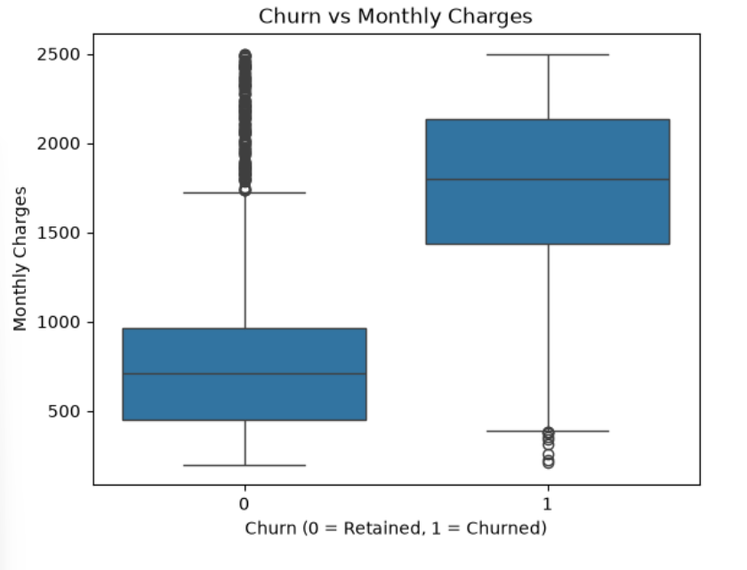
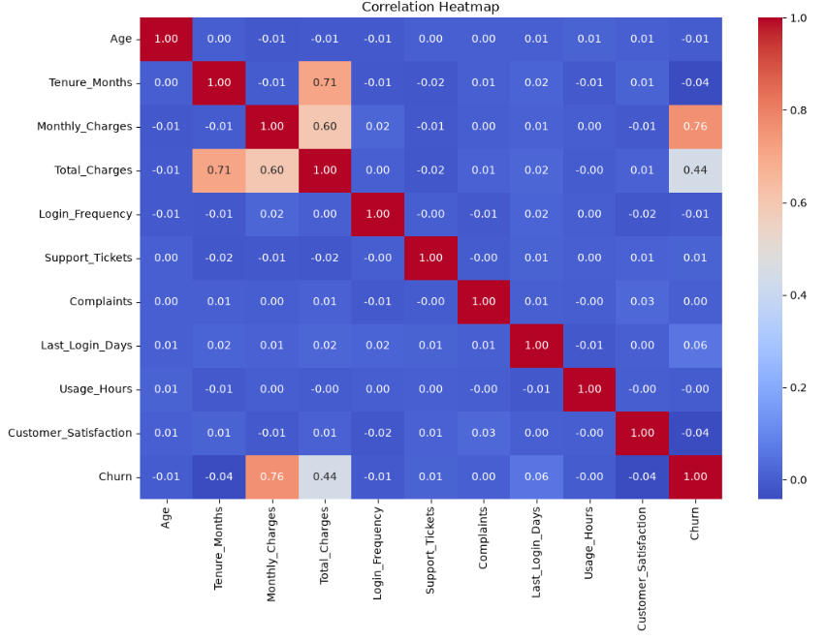
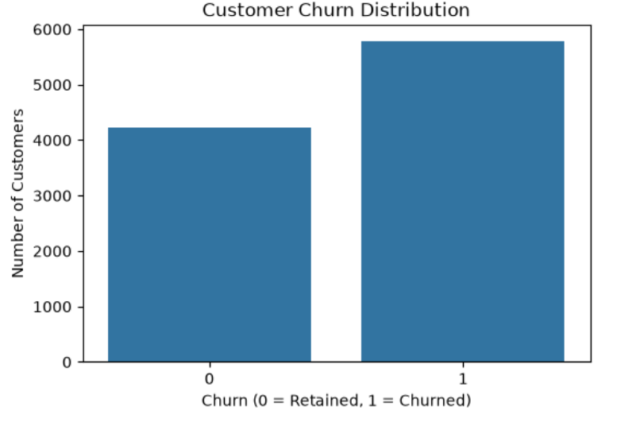
Exploratory Data Analysis
What I found from the data
Main observation:
Monthly Charges showed a strong relationship with Churn in this dataset.
Customer Churn Prediction & Risk Analysis
09 / 18
Notes:
[Transition] With clean data in hand, I explored it visually to understand customer behavior.
I created three charts: the customer churn distribution, churn versus monthly charges, and a correlation heatmap. [Data] The most important finding was that monthly charges showed a strong relationship with churn — as monthly charges rise, the churn rate climbs noticeably.
[Pause] That single observation shaped the next steps of the project.
Key points: ① Three exploratory charts ② Monthly Charges strongly linked to churn ③ Insight drives later modeling choices
Duration: 1.5 minutes

Slide 9
Feature Engineering
Features I created
Customer Lifetime Value
Engagement Score
Support Risk
Formula
Based on
Based on
Monthly Charges × Tenure
Login frequency · Usage · Recent activity
Support tickets · Complaints
Inactivity Flag
Risk Score
Identifies customers who have not
A simple risk score calculated from
logged in recently.
customer behavior indicators.
Customer Churn Prediction & Risk Analysis
10 / 18
Notes:
[Transition] The EDA pointed the way to smarter features, so I engineered five new ones.
I created Customer Lifetime Value as monthly charges times tenure, an Engagement Score based on login frequency, usage, and recent activity, a Support Risk score based on tickets and complaints, an Inactivity Flag for customers who have not logged in recently, and an overall Risk Score derived from customer behavior indicators.
[Pause] These features turned raw columns into signals the model could actually learn from.
Key points: ① Five engineered features ② Each captures a distinct behavior signal ③ Raw columns become meaningful predictors
Duration: 1 minute

Slide 10
Machine Learning Models
Models I Tested
MODELS I TESTED
Logistic Regression
Decision Tree
Random Forest
Model
Accuracy
F1 Score
Logistic Regression
91.35%
92.60%
Decision Tree
85.90%
87.70%
Random Forest
BEST
92.05%
93.25%
My observation
Random Forest gave the highest accuracy and F1 score, so I used it for the next stage.
Customer Churn Prediction & Risk Analysis
11 / 18
Notes:
[Transition] Now the core of the project — testing the models.
I tested three classification models: Logistic Regression, Decision Tree, and Random Forest. [Data] Logistic Regression reached 91.35% accuracy and a 92.60% F1 score, Decision Tree reached 85.90% and 87.70%, and Random Forest reached 92.05% accuracy and a 93.25% F1 score.
[Pause] Random Forest came out on top, so I used it for the next stage of the project.
Key points: ① Three models tested ② Random Forest scored highest on accuracy and F1 ③ Random Forest selected for the final stage
Duration: 1.5 minutes

Slide 11
Feature Importance
Which features mattered most?
Monthly Charges
0.22
Total Charges
0.19
Tenure
0.17
Usage Hours
0.15
Last Login Days
0.13
Customer Satisfaction
0.11
Age
0.09
Login Frequency
0.08
Support Tickets
0.06
Complaints
0.05
Relative feature importance score (Random Forest)
Important observation:
Monthly Charges had the highest feature importance in my model.
Customer Churn Prediction & Risk Analysis
12 / 18
Notes:
[Transition] Since Random Forest performed best, I then asked: which features actually drove its decisions?
The model showed higher importance for monthly charges, total charges, tenure, usage hours, last login days, customer satisfaction, age, login frequency, support tickets, and complaints. [Data] Monthly Charges had the single highest feature importance.
[Pause] That confirmed what the EDA had suggested earlier — pricing is the strongest churn signal here.
Key points: ① Ten ranked features ② Monthly Charges ranked highest ③ Confirms the earlier EDA insight
Duration: 1 minute

Slide 12
Customer Risk Prediction
After training the model
The model gives a churn probability for each customer, divided into three levels:
Low
Medium
High
0–30%
31–70%
71–100%
Churn probability
Churn probability
Churn probability
EXAMPLE
CUST10001
97%
CUST10002
39%
CUST10003
5%
CUST10001
High Risk
CUST10002
Medium Risk
CUST10003
Low Risk
Customer Churn Prediction & Risk Analysis
13 / 18
Notes:
[Transition] With a trained model, I could turn raw probabilities into something a business can act on.
The model gives each customer a churn probability, which I divided into three levels: 0 to 30% is Low risk, 31 to 70% is Medium risk, and 71 to 100% is High risk. [Data] For example, CUST10001 at 97% is High risk, CUST10002 at 39% is Medium, and CUST10003 at 5% is Low.
[Pause] So instead of a number, the business gets a clear action label.
Key points: ① Three probability bands ② Green / orange / red risk levels ③ Example customers mapped to each level
Duration: 1 minute

Slide 13
Customer Risk Report
Final Output
EXAMPLE OUTPUT
CSV report contains
Customer ID
Churn
Probability
Risk
Customer ID
CUST10001
1
97%
High
Actual Churn
CUST10002
0
39%
Medium
Churn Probability
CUST10003
0
5%
Low
Risk Level
customer_risk_report.csv
Columns: Customer ID · Actual Churn · Churn Probability · Risk Level
Customer Churn Prediction & Risk Analysis
14 / 18
Notes:
[Transition] All of that comes together in the final output — the customer risk report.
I generated a CSV report containing the Customer ID, the actual churn, the churn probability, and the risk level. [Data] For example: CUST10001 shows churn 1 at 97% High; CUST10002 shows churn 0 at 39% Medium; and CUST10003 shows churn 0 at 5% Low.
[Pause] The output file is customer_risk_report.csv — a reusable artifact, not just a one-off result.
Key points: ① CSV report with four fields ② Example rows for the three risk levels ③ Output file: customer_risk_report.csv
Duration: 1 minute

Slide 14
How This Can Be Used
Business Use
EXAMPLE
Identify high-risk customers
If a customer has a high churn
probability, the company can
Give attention to customers who may leave
check their issues and try to
retain them.
Understand customer behavior
Plan retention offers
Turn model output into a retention action.
Make decisions using customer data
Customer Churn Prediction & Risk Analysis
15 / 18
Notes:
[Transition] So why does this matter for the business?
The prediction can help a company identify high-risk customers, give attention to customers who may leave, understand customer behavior, plan retention offers, and make decisions using customer data. [Pause] Concretely: if a customer has a high churn probability, the company can check their issues and try to retain them.
[Pause] The model becomes a proactive tool, not just a report.
Key points: ① Five business applications ② Proactive retention focus ③ From prediction to action
Duration: 1 minute

Slide 15
What I Learned
What I Learned From This Project
How to work with a
How to clean and
How to perform EDA
real ML workflow
prepare data
How categorical data
How to split data into
How different ML
is converted into
training and testing
models work
numerical data
sets
How to evaluate
How to generate
How ML output can be
models using accuracy,
predictions from a
converted into a useful
precision, recall & F1
trained model
business report
Customer Churn Prediction & Risk Analysis
16 / 18
Notes:
[Transition] Stepping back, let me share what this project taught me as an intern.
I learned how to work with a real ML workflow, how to clean and prepare data, how to perform EDA, how categorical data is converted into numerical data, and how to split data into training and testing sets. I also learned how different ML models work, how to evaluate them using accuracy, precision, recall and F1 score, how to generate predictions from a trained model, and how ML output can be turned into a useful business report.
[Pause] In short — the full lifecycle, not just one isolated skill.
Key points: ① Nine practical learnings ② Covers the full ML lifecycle ③ Culminates in business-ready output
Duration: 1 minute

Slide 16
Future Scope
What can be added later?
01
Simple Streamlit dashboard
02
Customer-wise prediction page
03
Automated retention suggestions
04
Database integration
05
Real-time prediction
06
Cloud deployment
Customer Churn Prediction & Risk Analysis
17 / 18
Notes:
[Transition] Finally, here is where I would take this project next.
There is clear room to extend it: a simple Streamlit dashboard, a customer-wise prediction page, automated retention suggestions, database integration, real-time prediction, and cloud deployment. [Pause] These steps would turn the current prototype into a deployable, always-on tool.
Key points: ① Six extension ideas ② From prototype to product ③ Focus on real-time and deployment
Duration: 0.5 minutes

Slide 17
Conclusion
I worked on the complete process of customer churn prediction — from
data cleaning and analysis to Machine Learning and customer risk classification.
The final system can predict churn probability and divide customers into
Low, Medium and High risk categories.
Thank You!
Customer Churn Prediction & Risk Analysis
Presented by Neha Pandey · AI/ML Developer Intern
18 / 18
Notes:
[Transition] Let me bring it all together.
I worked on the complete process of customer churn prediction — from data cleaning and analysis to Machine Learning and customer risk classification. The final system can predict churn probability and divide customers into Low, Medium, and High risk categories. [Pause]
Thank you for your time — I'm happy to take any questions.
Key points: ① Full end-to-end process delivered ② System outputs three risk categories ③ Thank you and Q&A
Duration: 0.5 minutes

